Slide 1
BT 601: Analytical Biotechnology
-Prof. Siddhartha Sankar Ghosh
Lec-10

Slide 2
Applications of FRET in Boolean Logic

Slide 3
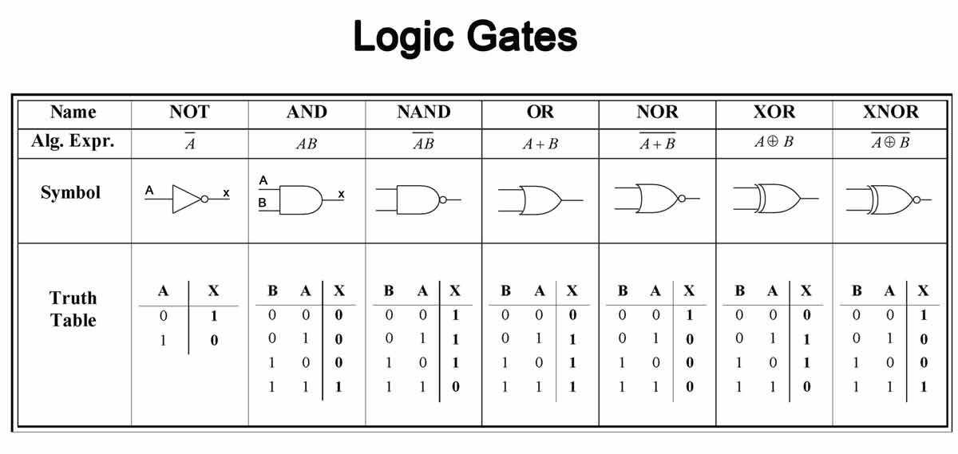

Slide 4
Deoxyribozyme-Based Logic Gates

Slide 5
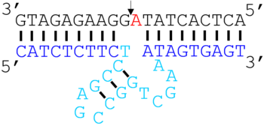
Deoxyribozymes, also called DNA enzymes, DNAzymes, or catalytic DNA, are DNA oligonucleotides that are capable of performing a specific chemical reaction

Slide 6
Basic Principle
A set of deoxyribozyme-based logic gates capable of generating any Boolean function.
Basic NOT and AND gates, followed by the more complex XOR gate were constructed.
These gates were constructed through a modular design that combines molecular beacon stem-loops with hammerhead type deoxyribozymes.
Importantly, as the gates have oligonucleotides as both inputs and output, they open the possibility of communication between various computation elements in solution.
The operation of these gates is conveniently connected to a fluorescent readout.

Slide 8
Mode of Operation

Slide 9

Single input YES Gate

Slide 11
AND Gate

Slide 12
AND NOT Gate:

Slide 13
XOR Gate

Slide 14
THANK YOU

